Slide 1
External Governance and Debt Structure
Sreedhar T. Bharath and Michael Hertzel
Presented by Nicholas Thompson

Slide 2
Research question
How does external governance pressure, particularly from product markets and the market for corporate control, influence a firm’s choice between bank loans and public debt?

Slide 3
Prior literature
Traditionally, corporate governance literature focuses primarily on shareholders’ influence on managers, neglecting creditors’ role, emphasizing it only in payment default states or agency conflicts.
Recent studies, however, suggest that creditors, particularly banks, play a role in governance outside payment default states (Denis & Wang, 2014).
Following technical default (i.e., debt covenant violations), creditors impose tighter restrictions on managers that benefit equity holders and debt holders, and CEO turnover increases (Nini, Smith, & Sufi, 2012).
Several papers provide evidence consistent with firms endogenously trading off creditor governance with other governance mechanisms (termed the “substitution of governance mechanisms” hypothesis).

Slide 4
Hypothesis
“The central hypothesis of our study is that strong external governance, as measured by an unfettered and active takeover market, as well as by a competitive product market, reduces the demand for the governance provided by banks and, thus, increases the likelihood that firms will issue debt publicly as opposed to borrowing from banks.”

Slide 5
Data
Period: 1982 to 2010
Bank loan data: DealScan
Public bond data: Securities Data Corporation (SDC) and Mergent FISD
Accounting data and information on company headquarters: Compustat
Industry information and competition measures: Hoberg-Phillips Data Library

Slide 6
Competition variables
Herfindahl-Hirschman Index (HHI) of industry concentration: A higher level of HHI implies greater industry concentration, which means less intense competitive pressure.
Competition1: Indicator variable set to one for all firms below the median value of the (text-based) TNIC HHI.
Competition2: Similar, except it substitutes missing values of TNIC HHI with a (more general) fitted HHI.

Slide 7
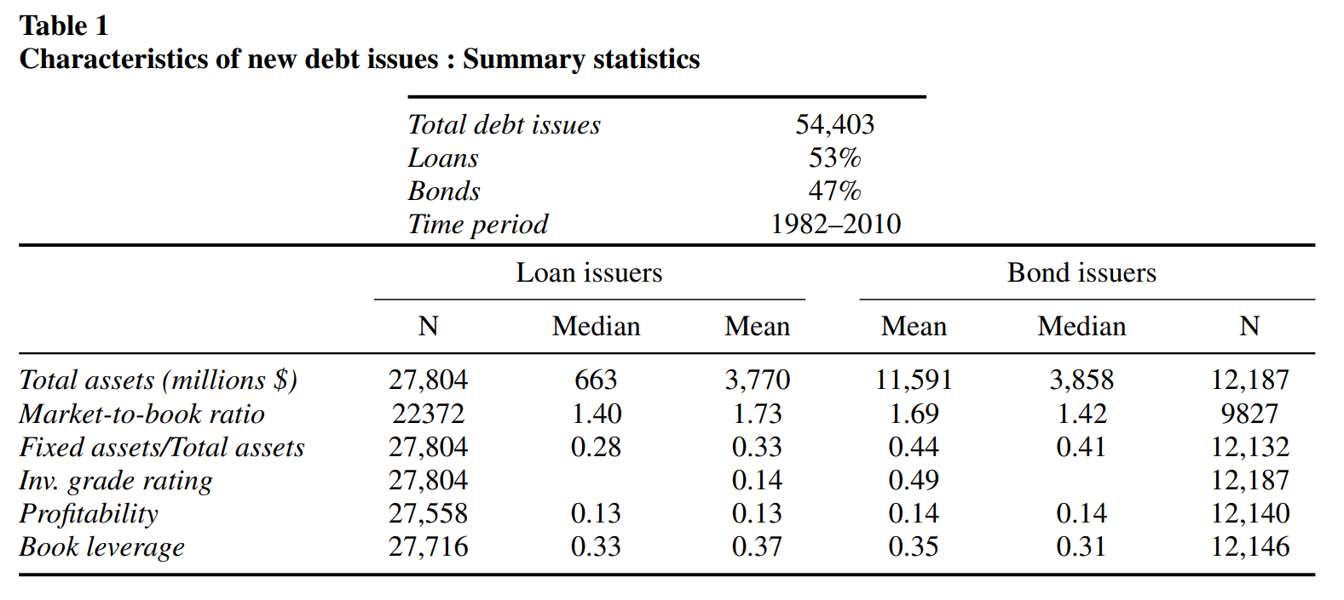
Notes:
The total number of debt issues analyzed is 54,403, with 53% being loans and 47% being bonds.
Median total assets for bond issuers is $3,858 million compared to $663 million for loan issuers.
49% of bond issuers have an investment-grade rating, whereas only 14% of loan issuers have such a rating.

Slide 8
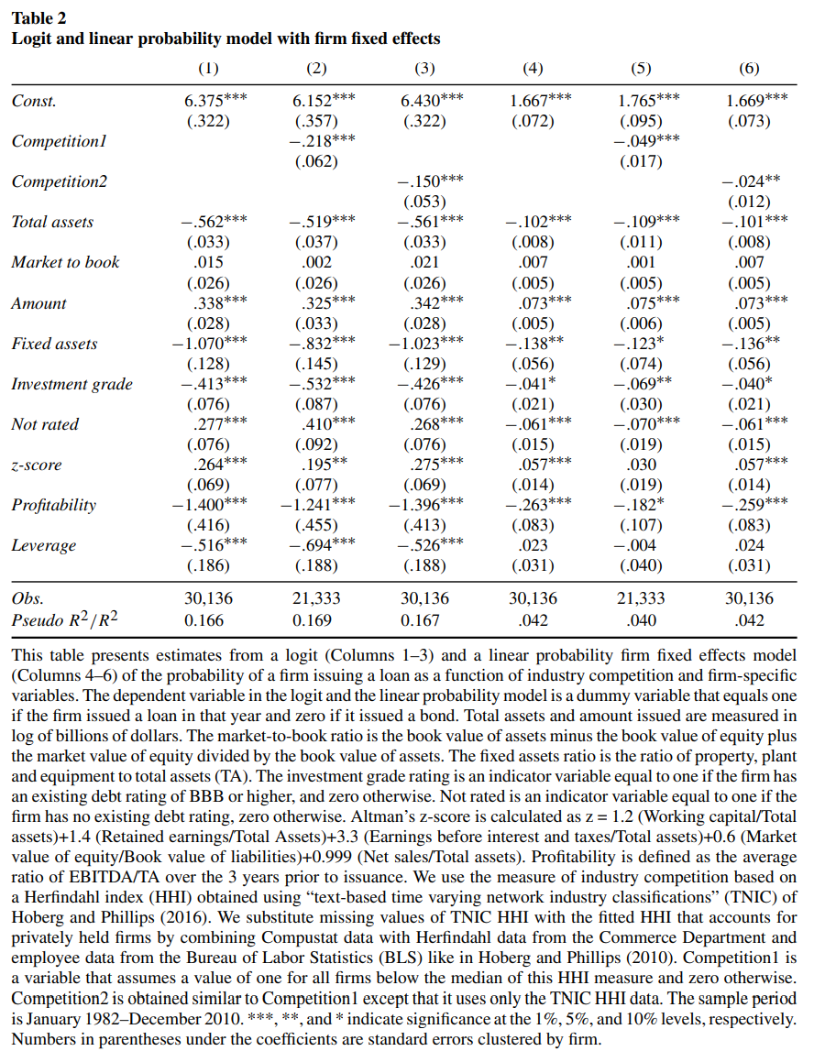
Logit (Columns 1-3) and linear probability firm fixed effects (Columns 4-6):
Control variables indicate weaker, less profitable firms are more likely to choose bank loans.
Competition1 and Competition2 indicate firms in less competitive industries are more likely to choose bank loans.

Slide 9
Quasi-natural experiments
The paper uses two quasi-natural experiments to isolate the causal effects of external governance on debt choice: reductions in industry-level import tariffs and passage of state antitakeover business combination (BC) laws.
Import tariff reductions are used as an exogenous shock to increase product market competition, thereby increasing external governance pressure.
The passage of BC laws helps to measure a decrease in governance pressure from the takeover market.

Slide 10
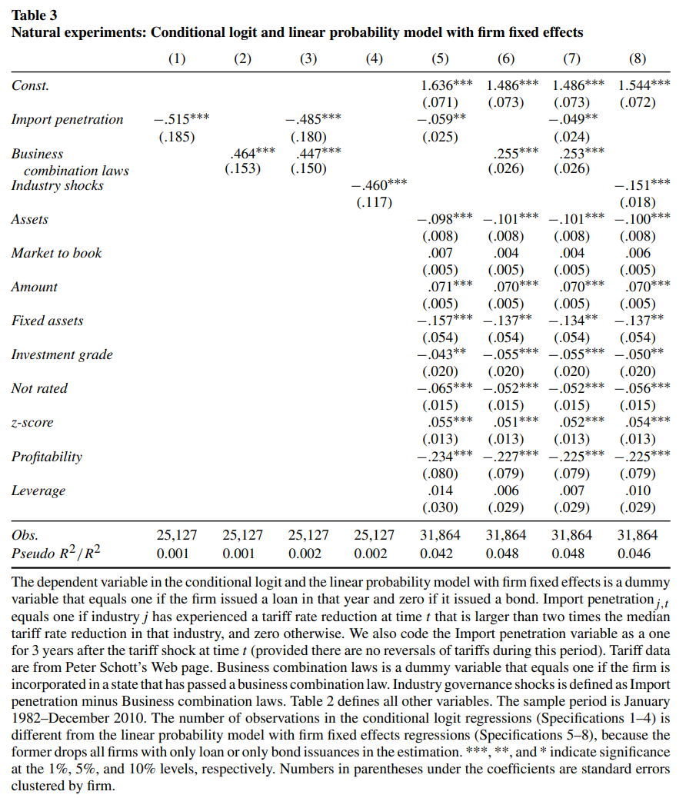
Logit (Columns 1-4) and linear probability firm fixed effects (Columns 5-8):
Following import penetration (tariff reductions), firms are less likely to choose bank loans.
Following antitakeover BC laws, firms are more likely to choose bank loans.
The result is consistent when combining variables.
Notes:
“For example, the coefficient estimate of −0.06 in the fixed effects linear probability model specification implies that bank loans are 6% less likely following a competitive shock.”

Slide 11
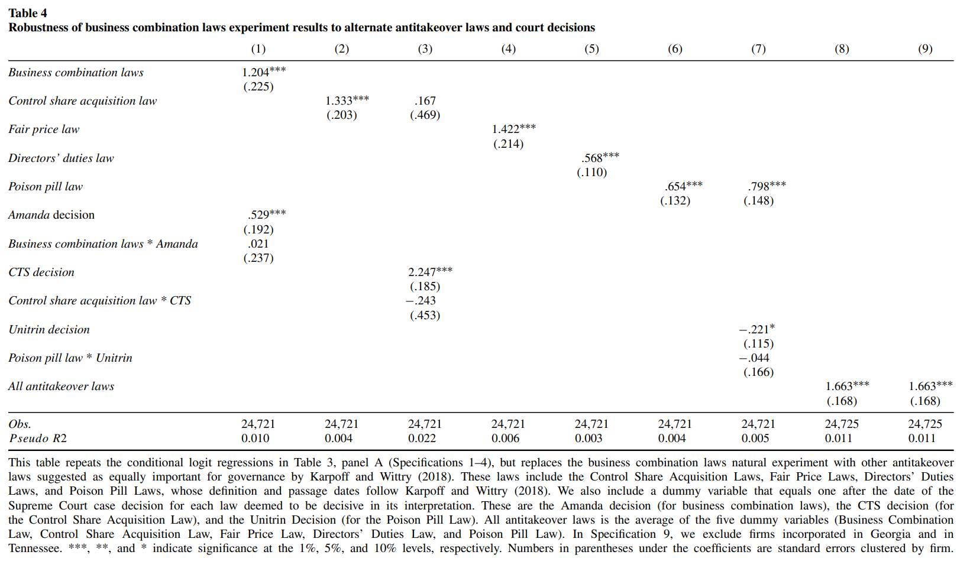
Notes:
Firms are likelier to choose bank loans following a variety of antitakeover measures (and related court decisions), not just business combination laws.

Slide 12
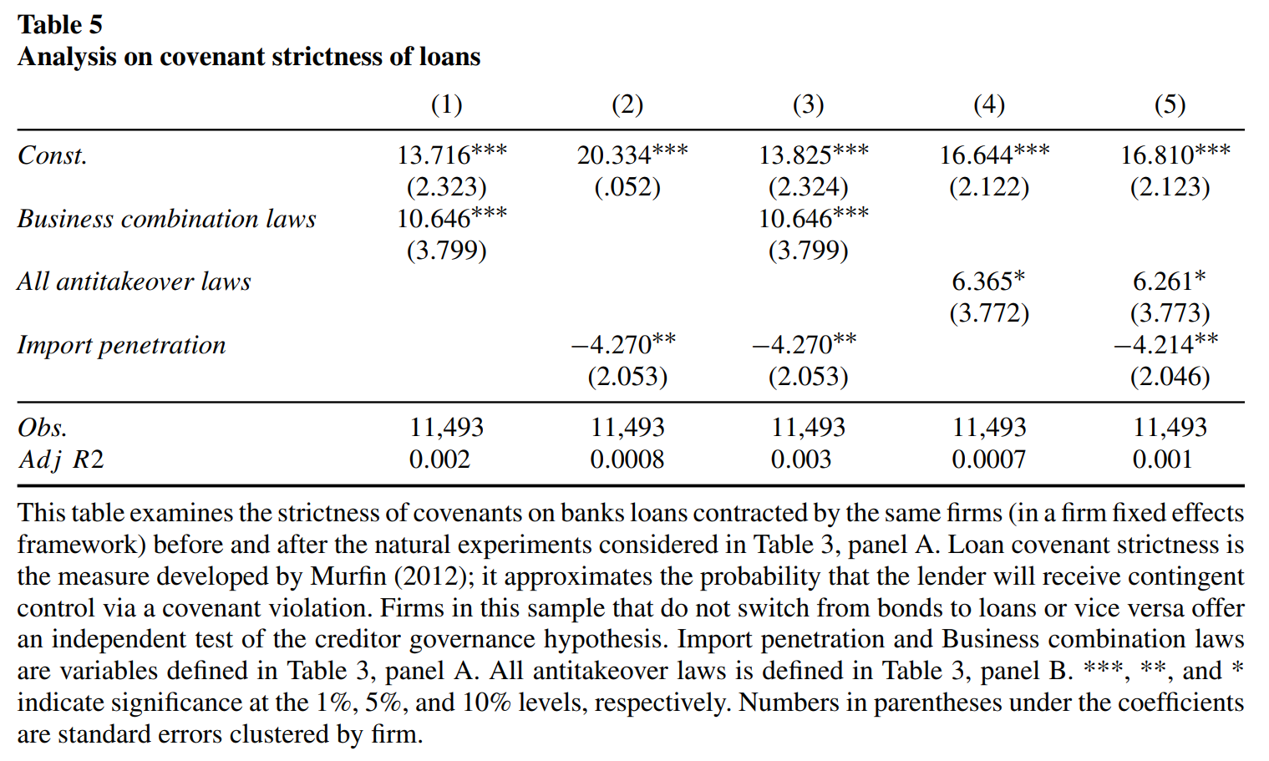
Notes:
The covenant strictness of loans is higher following antitakeover laws and lower following import penetration.

Slide 13
Cross-sectional analysis of the effect of external governance
The paper examines whether the impact of external governance shocks varies across different industry characteristics, such as industry competition and the importance of long-term customer-supplier relationships.

Slide 14
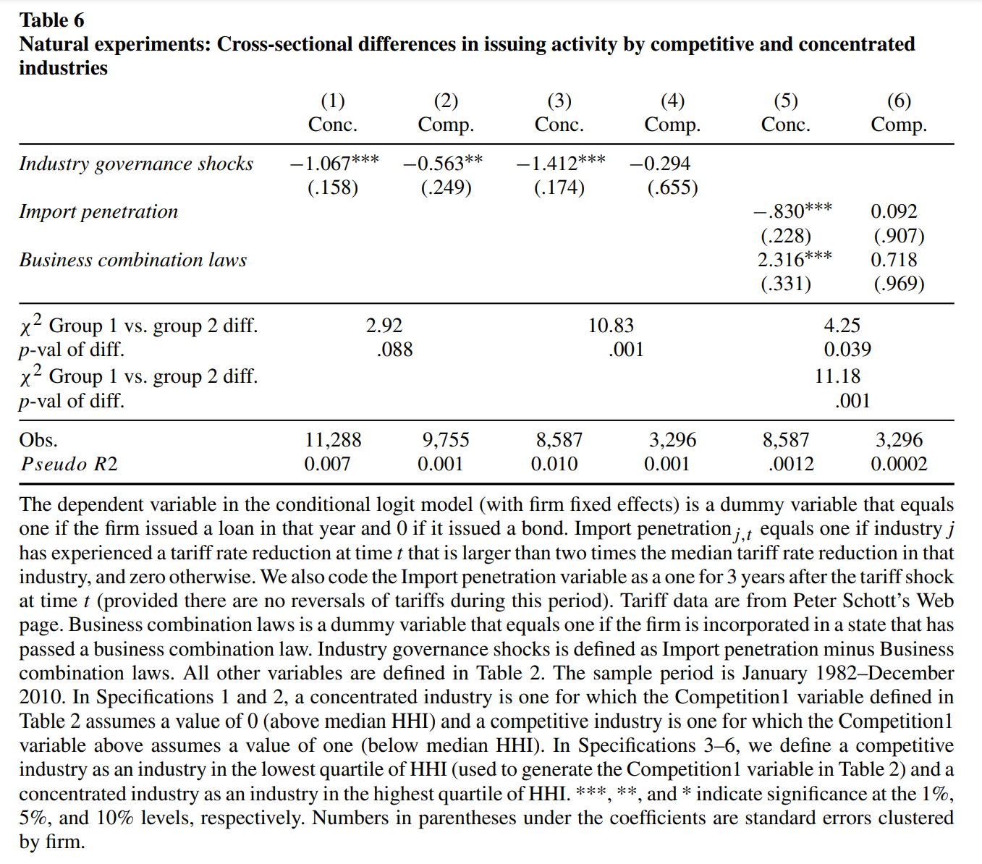
Columns 1 and 2 use a median split of HHI, and Columns 3-6 compare firms in the upper versus lower quartiles of HHI.
Conclusion: Firms in more concentrated industries tend to have a greater need for governance, as indicated by their increased reliance on bank debt.

Slide 15
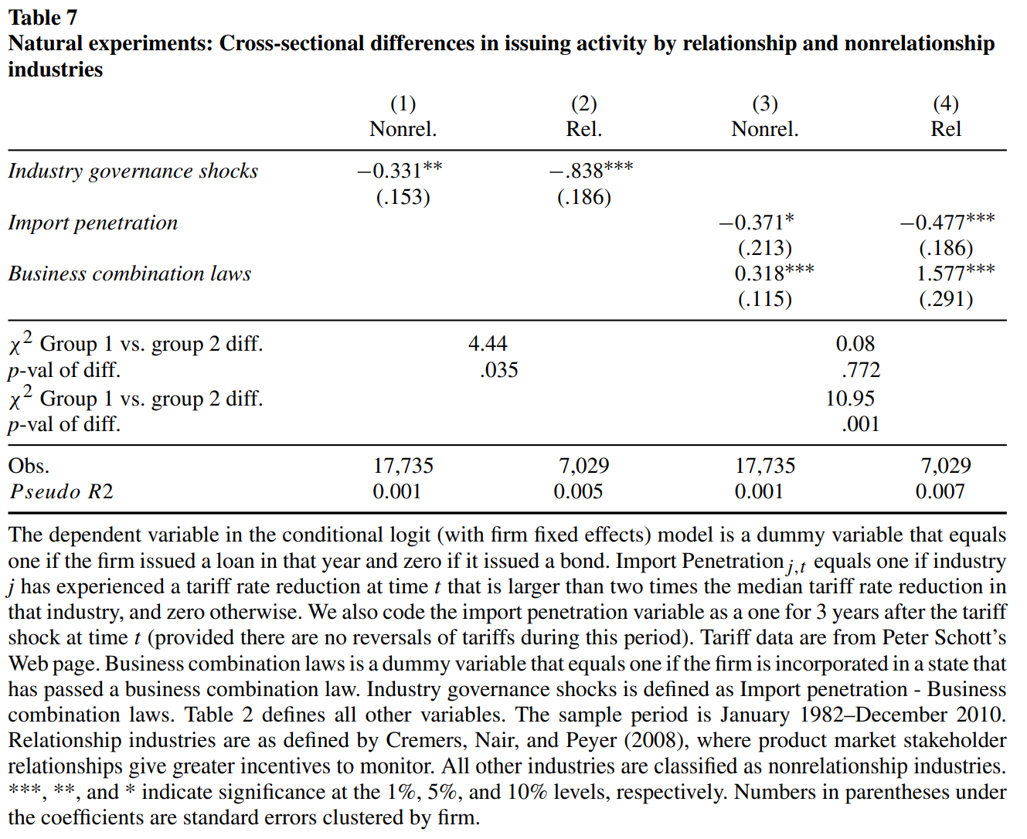
There is a greater substitution effect for firms in relationship industries.
This effect is driven mostly by the subsample of firms in the BC law experiment.

Slide 16
Conclusion
The paper provides evidence that firms substitute different governance mechanisms in response to changes in external governance pressure.
Firms facing increased competition rely less on bank debt, whereas firms facing reduced takeover threats take on more, suggesting that external governance mechanisms can substitute for bank monitoring.

